Slide 2
Learn simple linear regression and multiple linear regression

Slide 3
Simple Linear Regression

Slide 4
Simple Linear Regression

Slide 5
Simple Linear Regression

Slide 6
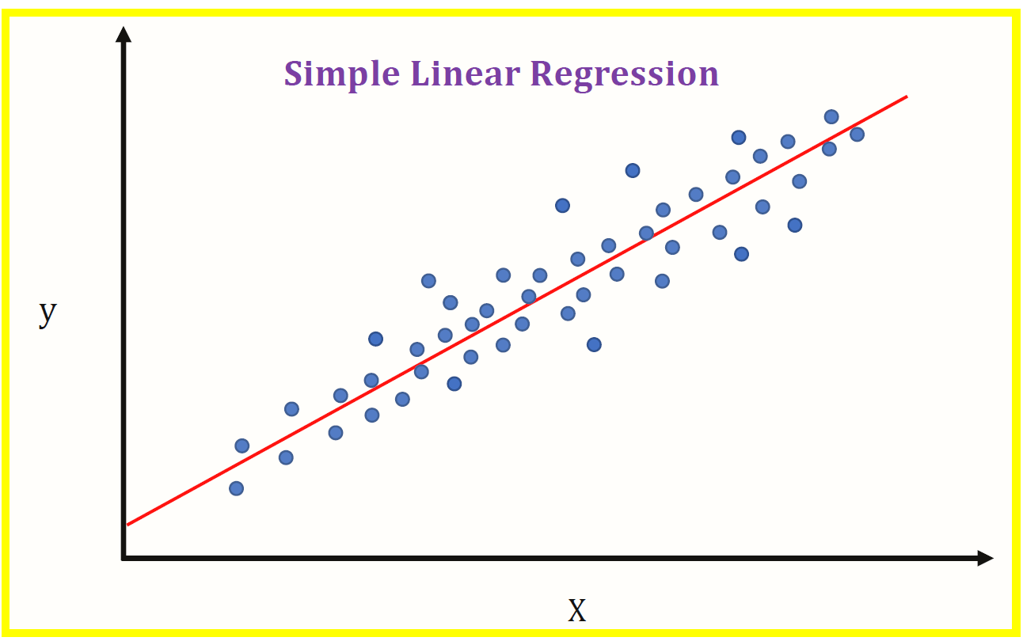
Introduction

Slide 7
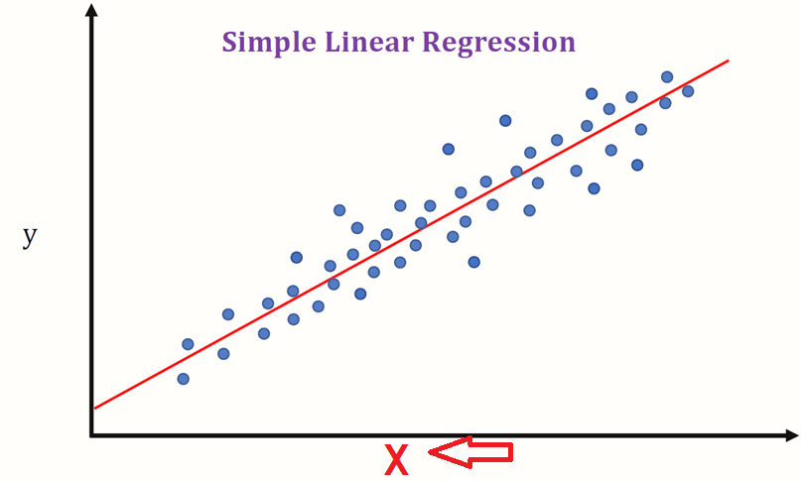
Introduction

Slide 8
Introduction
predictor, explanatory, or independent variable.

Slide 9
Introduction
predictor, explanatory, or independent variable.

Slide 10
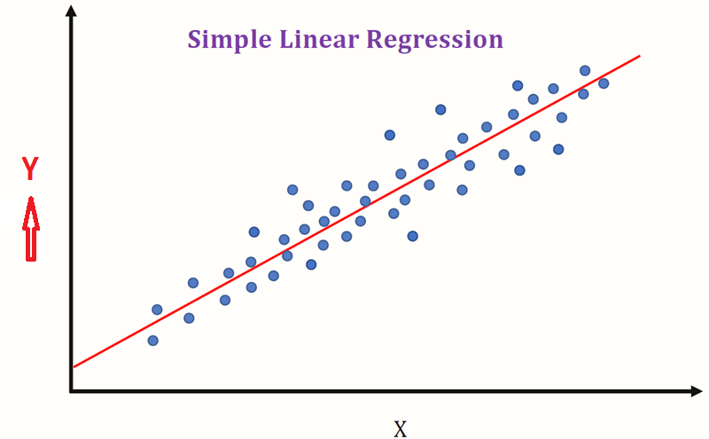
Introduction
regarded as the response, outcome, or dependent variable.

Slide 11

What is the objective of Linear regression ?

Slide 12
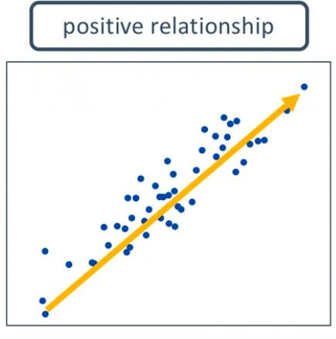
When to use regression ?

Slide 13
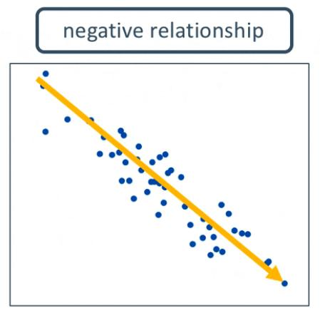
When to use regression ?

Slide 14
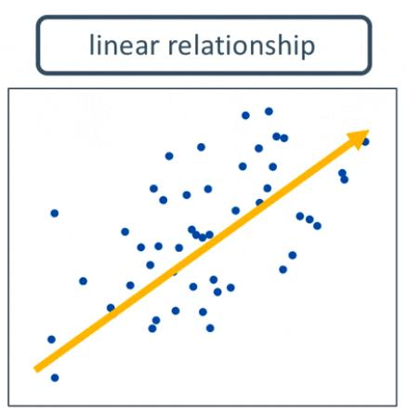
When to use regression ?

Slide 15
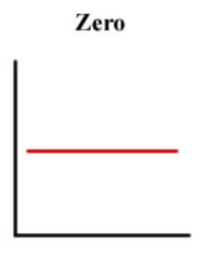
When to use regression ?

Slide 16
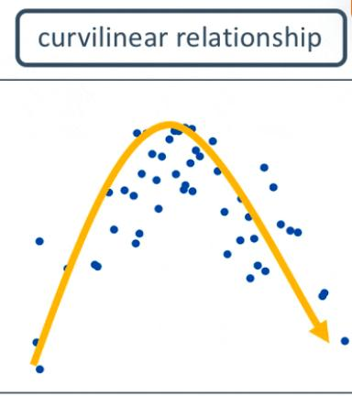
When to use regression ?

Slide 17
Linear Regression
In the context of Statistical learning, there are two types of data
Independent variables
Dependent variables:

Slide 18

Linear Regression
What do we mean by linear?

Slide 19
Linear Regression
Linear Equation
y = mx+c
y is the dependent variable.
x is the independent variable
m is the slope
c is the intercept

Slide 20
Linear Regression
models are not perfect.
approximate the relationship between dependent and independent variables
Approximation leads to errors.
irreducible error

Slide 21
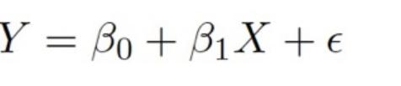
Linear Regression
The same equation of a line can be re-written as:

Slide 22
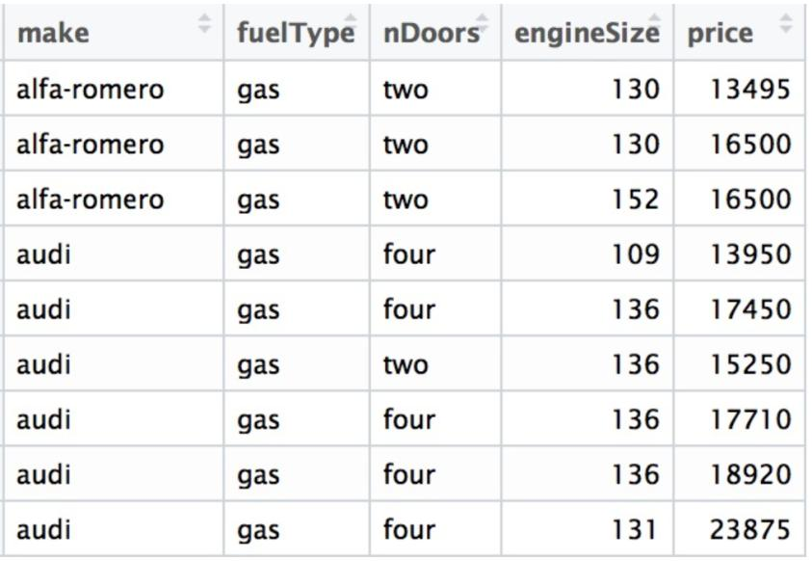
Linear Regression
Example

Slide 23
Linear Regression
The following questions are addressed in the first
set of analyses:
Is price of car price related with engine size?
How strong is the relationship?
Is the relationship linear?
Can we predict/estimate car price based on engine size?

Slide 24
Linear Regression
Fernando does a correlation study.
Determining how closely two variables are linked.
Its value ranges from 0 to 1.
When the correlation coefficient is large (> 0.7),__________
The presence of a big -ve number ______________

Slide 25
Linear Regression
He plots the relationship between price and engine size.
He splits the data into training and test set.
75% of data is used for training. Remaining is used for the test.

Slide 26
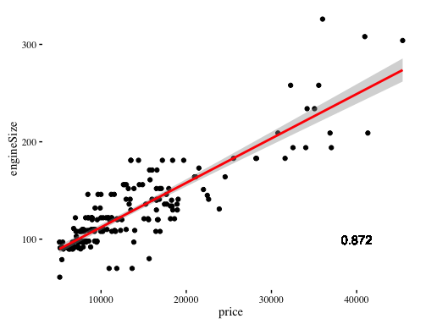
Linear Regression

Slide 27
Linear Regression
Following are the answers to the questions:
Is price of car price related with engine size?
Yes, there is a relationship.

Slide 28
Linear Regression
Following are the answers to the questions:
Is the relationship linear?
A straight line can fit => A decent prediction of price can be made using engine size.

Slide 29
Linear Regression
Following are the answers to the questions:
Can we predict/estimate the car price based on engine size?
Yes, car price can be estimated based on engine size.

Slide 30
Multiple linear regression
Multiple linear regression is used to estimate the relationship between two or more independent variables and one dependent variable. You can use multiple linear regression when you want to know:
  How strong the relationship is between two or more independent variables and one dependent variable
  The value of the dependent variable at a certain value of the independent variables

Slide 31
Assumptions of multiple linear regression
Homogeneity of variance (homoscedasticity):
  Independence of observations
  Normality
  Linearity

Slide 32
How to perform a multiple linear regression

Slide 33
How to perform a multiple linear regression

